Slide 1
Taco Mania Insights Report

Slide 2
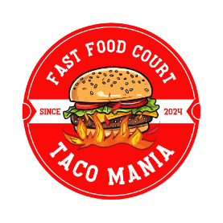
Content
PROBLEM STATEMENT
DATA ACQUISITION AND VALIDATION
DATA MODELLING
INSIGHTS

Slide 3
Problem Statement: Understanding key financial drivers to improve decision-making and ensure sustainable business growth
Key Focus Areas: • Financial Performance Overview • Business Optimization Opportunities • Financial Planning & Budget Recommendations
Objective: Deliver actionable insights using data visualization to support strategic financial decisions.

Slide 4
Data Acquisition and Validation
Primary Data Sources:
Snowflake – Centralized data warehouse for financial and transactional data
CRM System – Customer-level data including channel performance
SQL Database – Budget and product SKU-level details
Excel Files – Actual vs. budget reports
Data Types Extracted:
Product SKU Metadata
Financial KPIs (Revenue, Cost, Margin)
Planned vs. Actual Budgets
Sales Channels (Direct,Online,Domestic etc.)

Slide 5
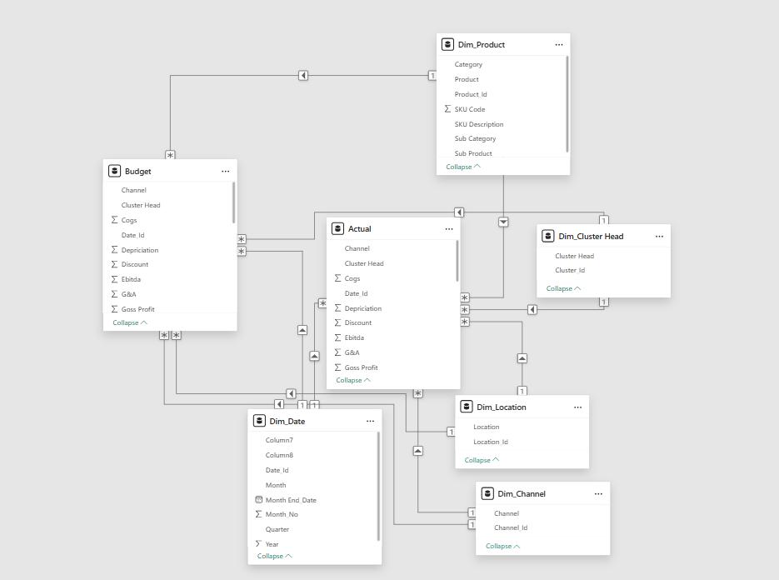
Data Modelling

Slide 6
Financial Overview Metrics (Performance Analysis)
The business generated a total Net Revenue (NR) of ₹560.07 million, indicating strong sales performance.
Gross Profit (GP) stands at ₹162.50 million, showcasing a healthy margin from overall sales.
Actual EBITA achieved is ₹88.30 million, reflecting operational efficiency.
Profit After Tax (PAT) is ₹61.13 million, confirming strong bottom-line performance.
A total of 264.95K units were sold, highlighting a significant volume movement.
The company offers a wide product portfolio, with 4,207 Stock Keeping Units (SKUs).

Slide 7
OPTIMIZATION OF BUSINESS (Mekko Chart)
Key Insights:
Protein Pack (22.4% SKUs → 39.5% NR)
Fresh Fare (31.15% SKUs → 14.6% NR)
Country Fries (2.9% SKUs → 13.7% NR)
Crunch & Munch (17.9% SKUs → 12.7% NR) Recommendations
Optimize the SKU Portfolio of Fresh Fare and Crunch and munch by reducing redundant units
Scale High-Performing categories like Country Fries and Protein pack

Slide 8
OPTIMIZATION OF BUSINESS (Quadrant Analysis)
Key Insights:
Upper Quadrant [Protein Pack (High NR ; High GP)]
Middle Quadrant[Country Fries,Crunch & Munch , Fresh Fare(High NR ; Low GP)]
Lower Quadrant [Frosty Veggies,Frosted Fare,Sweet Crust,Cake,others(Nil NR ; Nil GP)]
Recommendations
Maintain and expand the SKU portfolio of Upper Quadrant categories
For the Middle Quadrant categories analyze the unit economics and adjust the pricing strategy to improve profitability
For Lower Quadrant categories consider repositioning of the products and limit resources to minimize losses

Slide 9
OPTIMIZATION OF BUSINESS (Pareto Analysis 20-80)
Key Insights:
20-30 % SKU’s that drive majority revenue :
[SKU Codes : 2589,1647,5548,2582,5698,8982,6386,9868,7928,8972,7827,8985,8589]
80% SKU’s that drive least revenue
Recommendations
Focus resources on the core SKU’s that drive majority revenue and regularly monitor it’s performance to protect this revenue base
Evaluate the long tail SKU’s that drive least revenue and either discontinue ,reposition or bundle it out to clear inventory

Slide 10
BUDGETING ANALYSIS (PVM Analysis)
Net Revenue exceeded budget by ₹45.09M
Strong overall performance despite challenges in volume.
Volume decline impacted revenue negatively (-₹25.26M)
Indicates lower units sold than expected.
Mix improvement added ₹1.86M
Suggests sales shifted towards higher-margin or higher-priced SKUs.
Metric | Value
Actual NR | 289.53M
Budget NR | 244.44M
Volume Impact | -25.26M
Price Impact | +16.11M
Mix Impact | +1.86M
Net Variance(vs Budget) | +45.09M(Actual NR – Budget NR)

